Slide 1
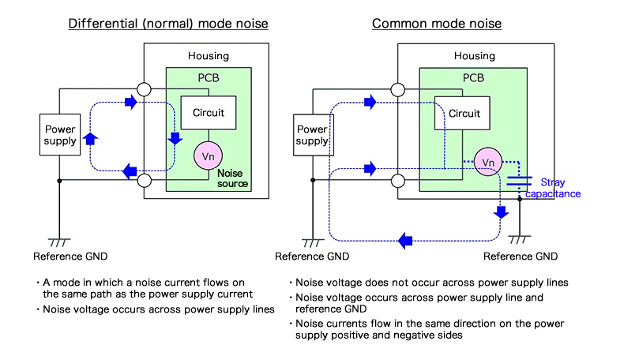
Common Mode Noise

Slide 2
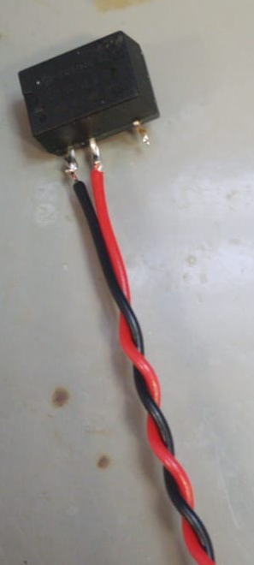
Common Mode Noise
High side isolated converter

Slide 3
Common Mode Noise

Slide 4
Common Mode Noise

Slide 5

SCP

Slide 6
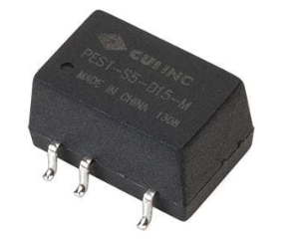
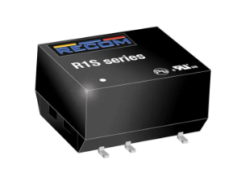
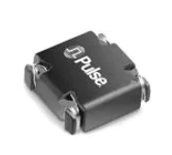
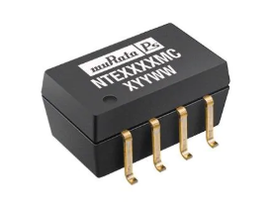
Power Converters
C_{iso} -> Not given
C_{iso} -> 15 pF
PES1-S5-S9-M
R1S-0509/HP
C_{iso} -> 35 pF
PL8209
6 kohm @ 10 MHz
NTE0505MC
R1S-0505/HP

Slide 7
Thesis Outline
Introduction
Gate Charge Characterization (EPFL, TPEL), Output Capacitance Characterization (Göksu + Enes)
Modelling and Switching Characteristics (EPE + ECCE)
Half-Bridge Design, Layout, SC, Paralleling (TPEL)
DC/DC Converter Design (TPEL)
5-ph Inverter Design (Optional ?)
Conclusion

